Slide 1
Web Application Development ISCG7420 Introduction to Web Development
School of Computing, Electrical and Applied Technology

Slide 2
Outlines – Simple Blog
Authentication
Login
Registration
Logout
HTML Styling
Adding more Models
context_processors
Permission

Slide 3
Create an app for authentication
python manage.py startapp members
Create urls.py in the new app
Register your app to setting
Register your urls in member folder to urls in root folder

Slide 4
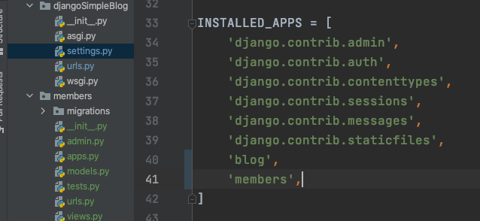
Register your app to setting

Slide 5
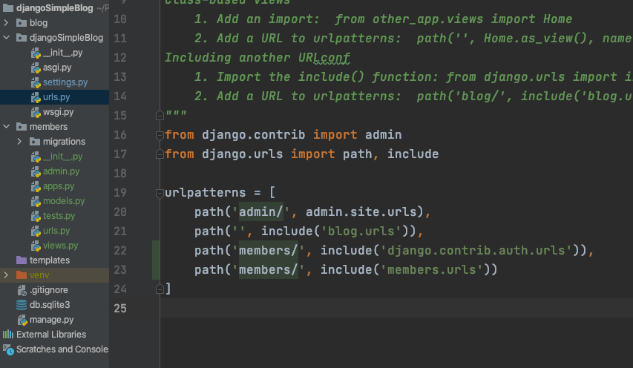
Register your urls in member folder to urls in root folder

Slide 6

Create templates folder for member app

Slide 7
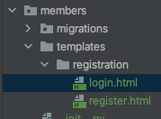
Registration
Registration template
Create a folder inside templates folder
Create two files
login.html
register.html

Slide 8
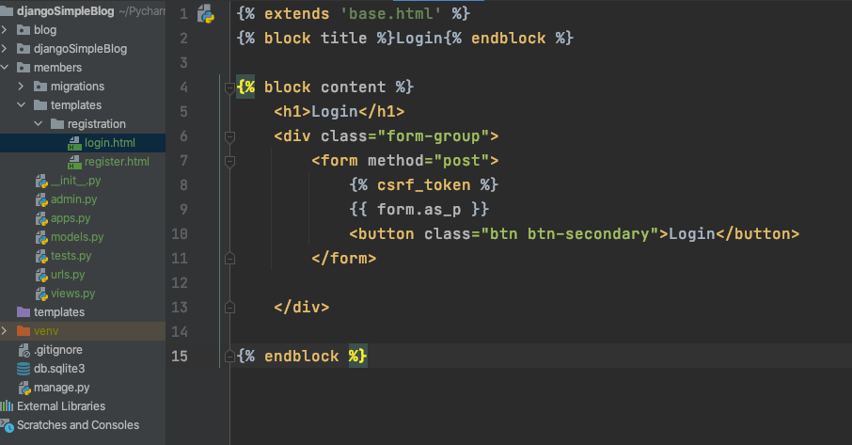
login.html

Slide 9
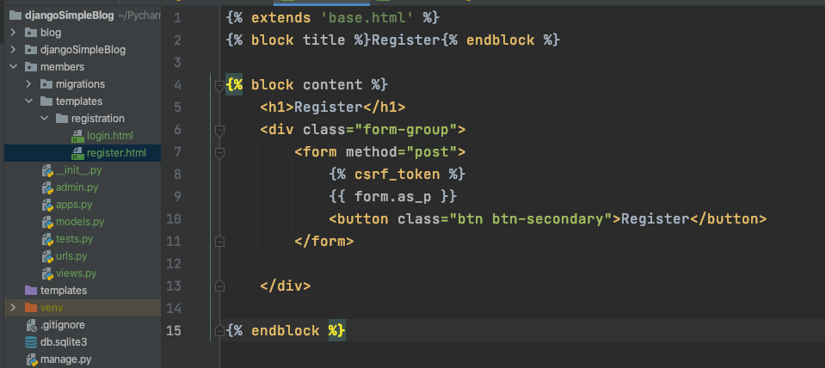
register.html

Slide 10
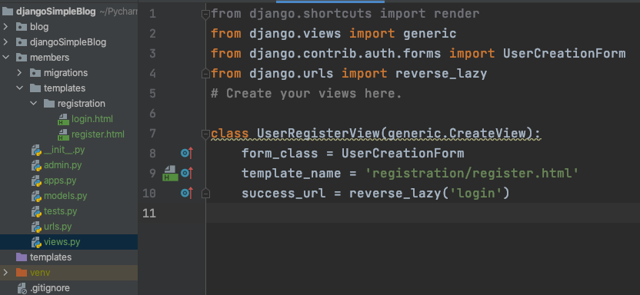
Views – Generic CreateView
form_class
template_name
success_url

Slide 11
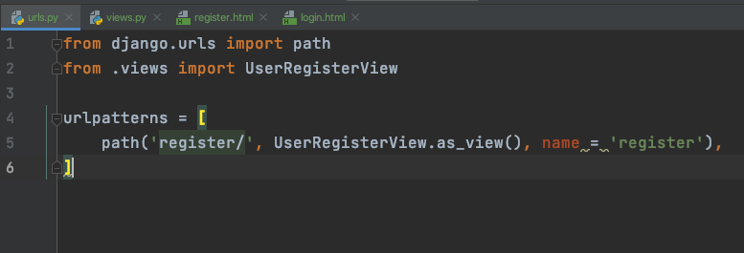
Register your new views to urls.py

Slide 12
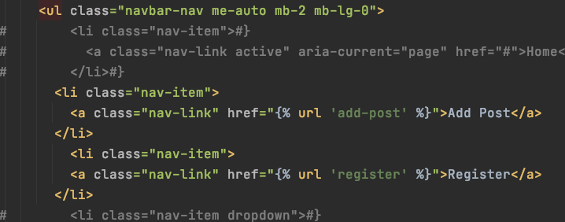
Create a link in Nav Bar
base.html

Slide 13
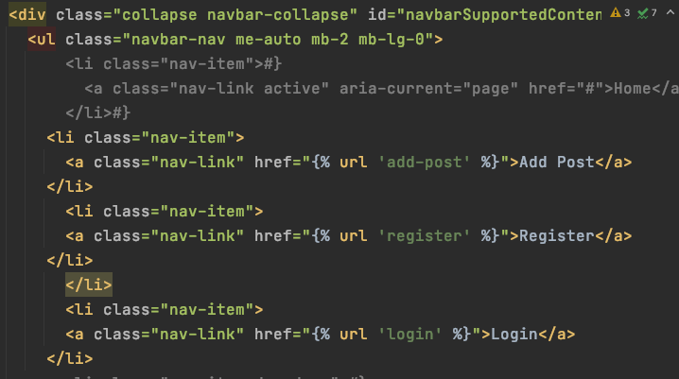
Create login
Add link in Nav Bar (base.html)

Slide 14

Login redirect
In settings.py

Slide 15
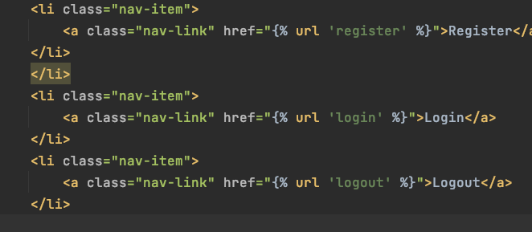
logout
Create a link on nav bar

Slide 16
Authenticated
user.is_authenticated
{% if user.is_authenticated %} Add Post
Logout {% else %} Register
Login {% endif %}

Slide 17
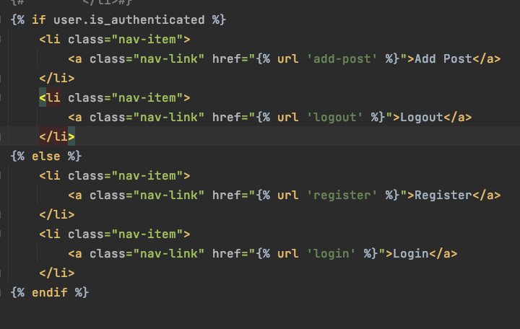
Base.html

Slide 18
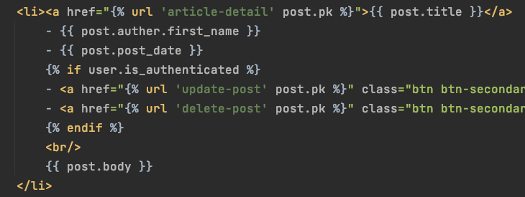
Home page

Slide 19
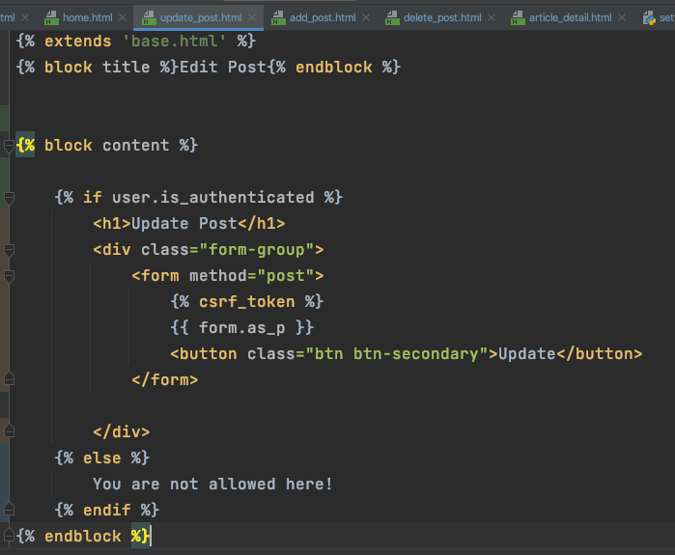
Update post page

Slide 20
Please finish for:
Add post page
Delete post page
Post detail page

Slide 21
Styling
Create a huge post body
https://www.lipsum.com/
Generate from url above

Slide 22

HTML in Textarea
Add <p> or some html element in your body. Try this, also add safe to home page.

Slide 23
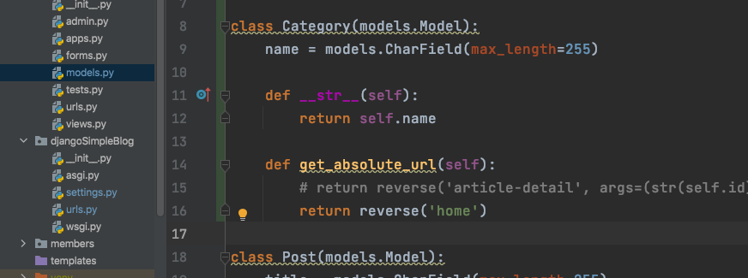
Add a model for post category

Slide 24
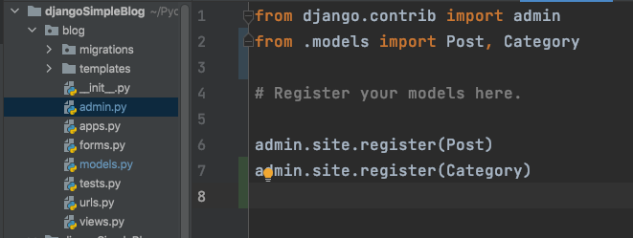
Register you model to admin
makemigrations and migrate

Slide 25
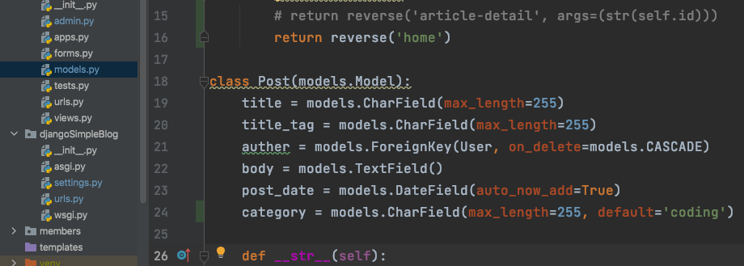
Add category attribute to your Post
makemigrations and migrate

Slide 26
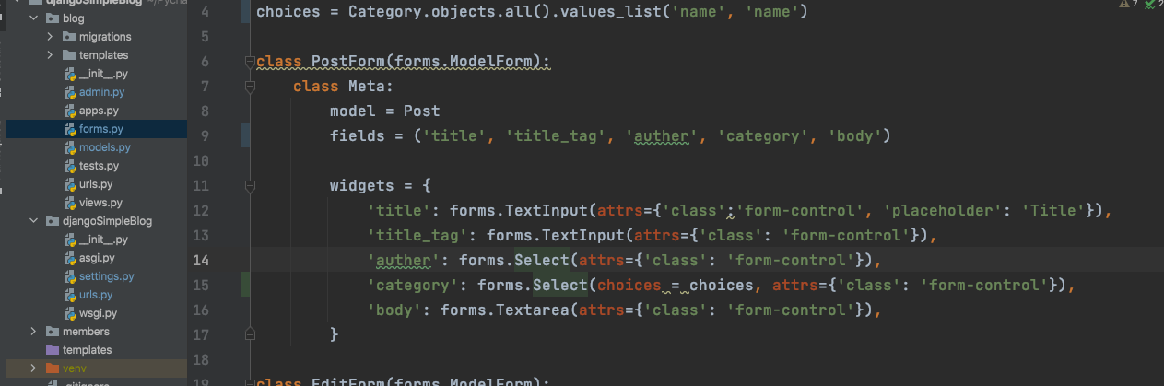
Add new textbox to you form

Slide 27
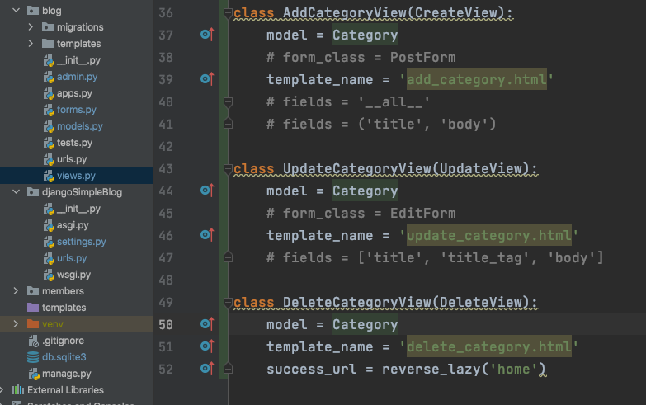
Create views for Category
I forget to enable fields here

Slide 28
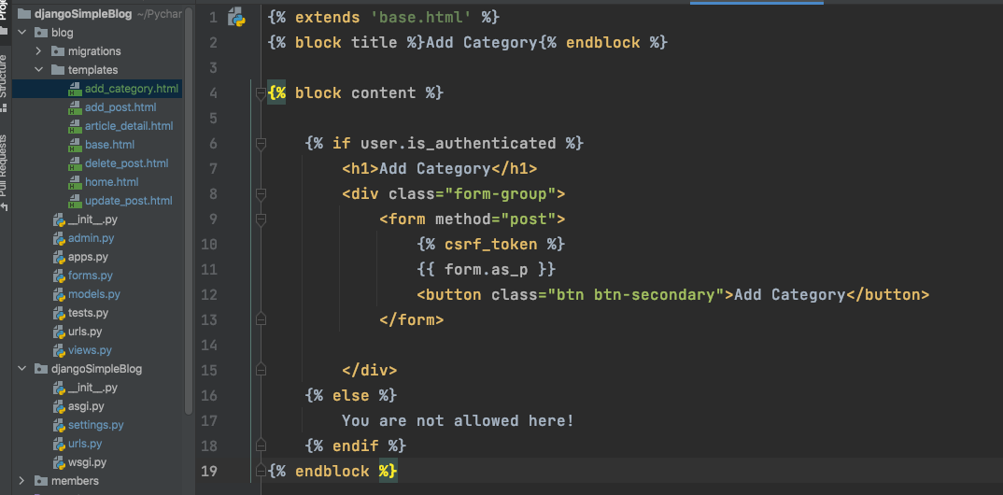
Create Templates for Category
Add

Slide 29
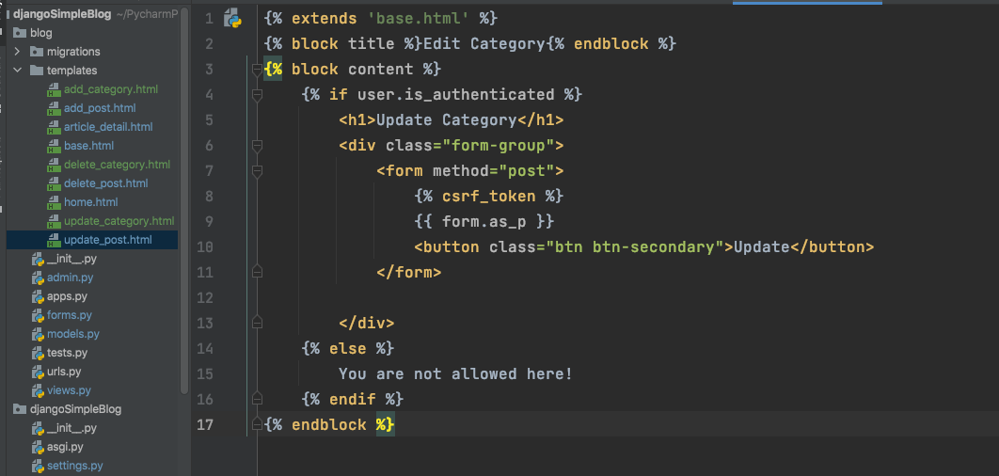
Update template

Slide 30
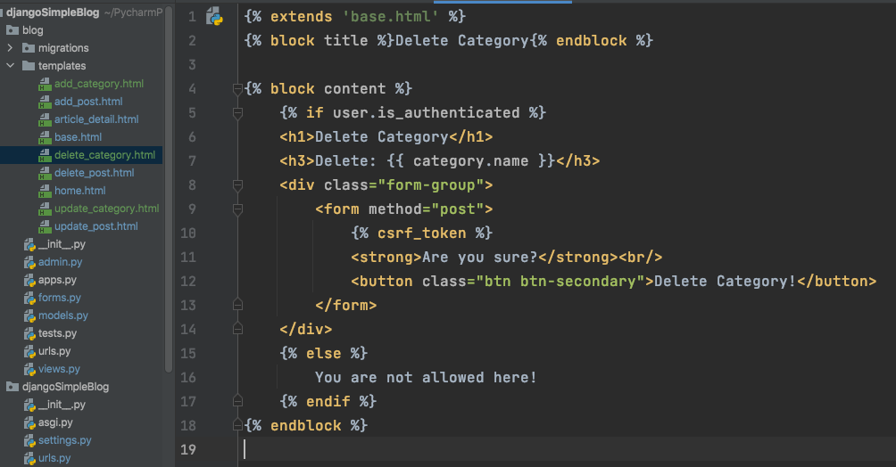
Delete View

Slide 31
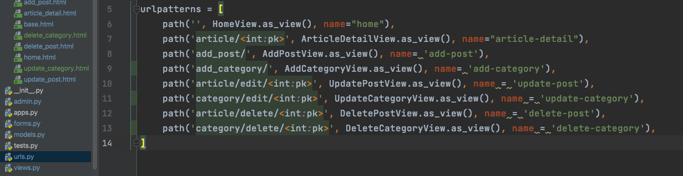
Urls register

Slide 32
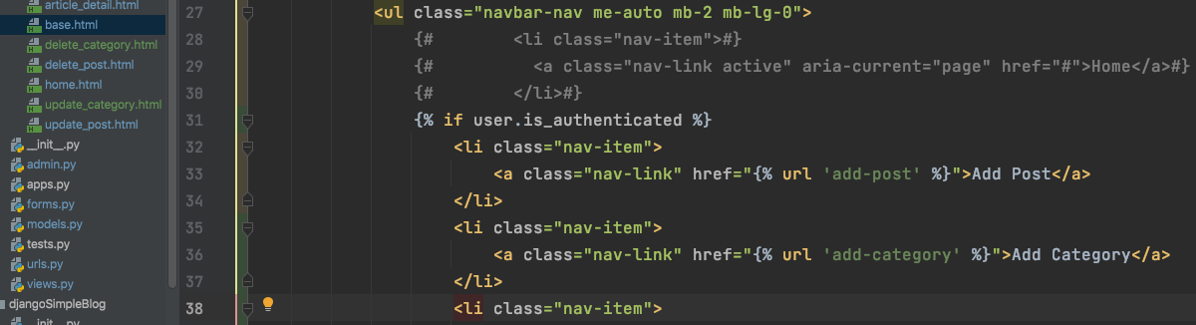
Add urls on your nav bar

Slide 33
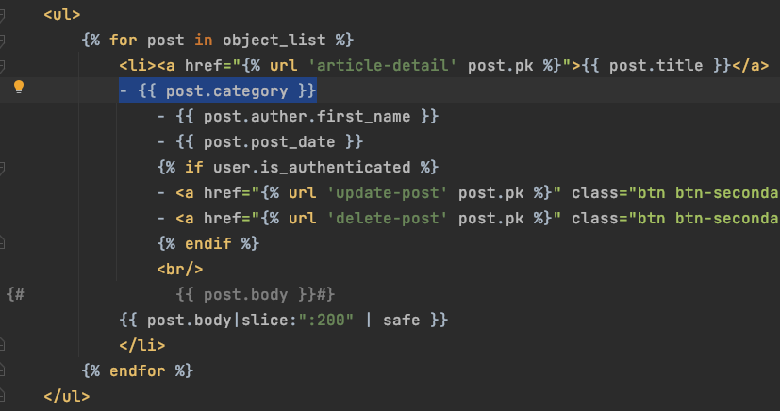
Add category to home page

Slide 34
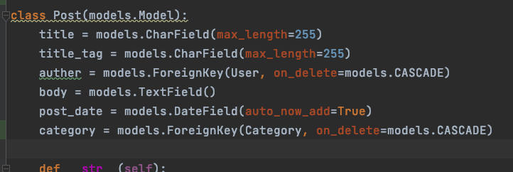
Foreign Key

Slide 35
This is little bit trouble
1. add one line down category
category1 = models.ForeignKey(Category, on_delete=models.CASCADE, default=1)
Change forms.py post class, take out category
makemigration and migrate
Remove category
makemigration and migrate
Change category1 to category
makemigration and migrate
You’d better to follow me in the class

Slide 36
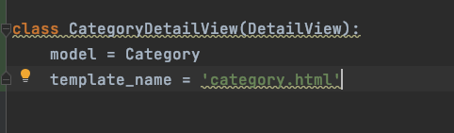
Create a DetailView for Category

Slide 37
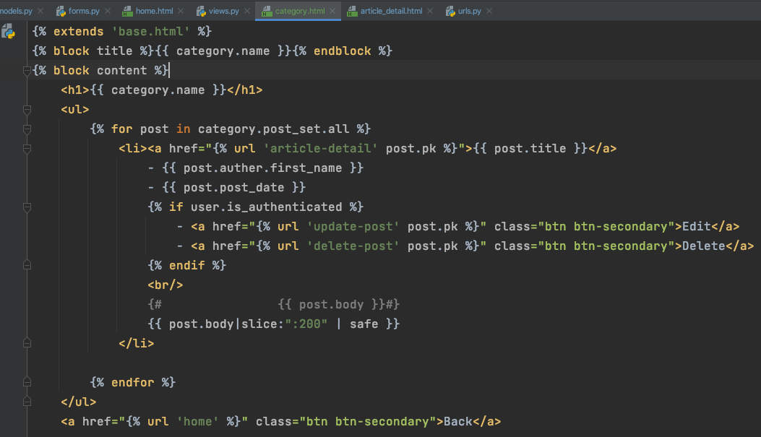
Create template file

Slide 38
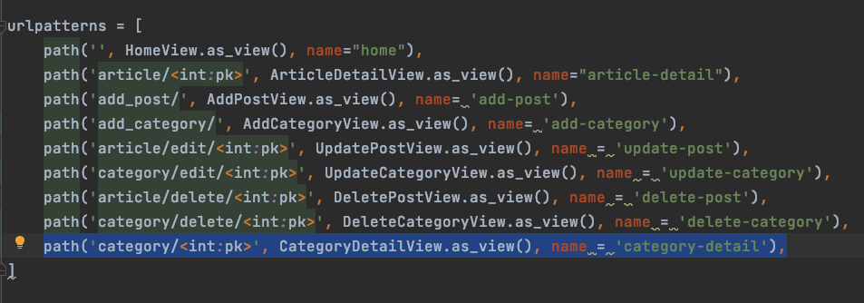
Register your view to urls

Slide 39
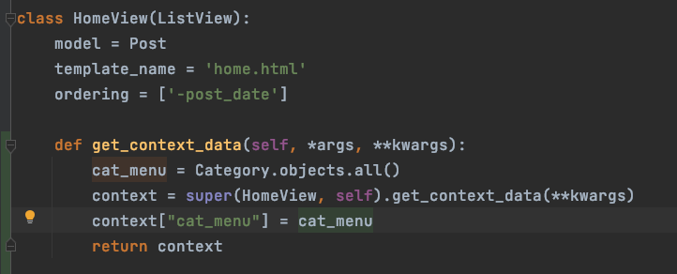
Add Blog Category Navbar Links
Override get_context_data

Slide 40
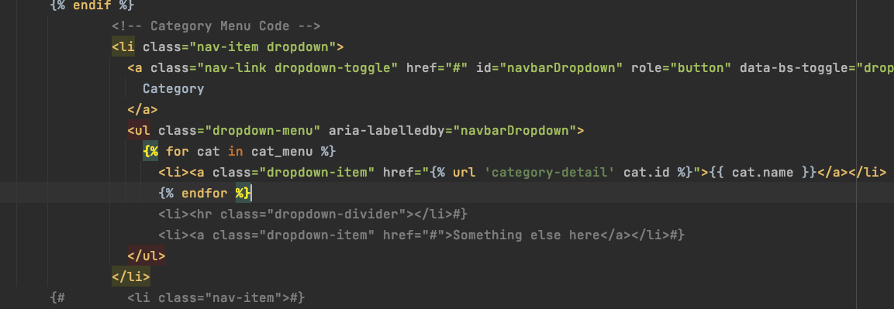
Base.html

Slide 41
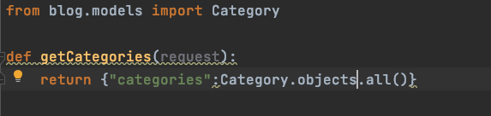
context_processors.py
https://docs.djangoproject.com/en/3.2/ref/templates/api/#writing-your-own-context-processors

Slide 42
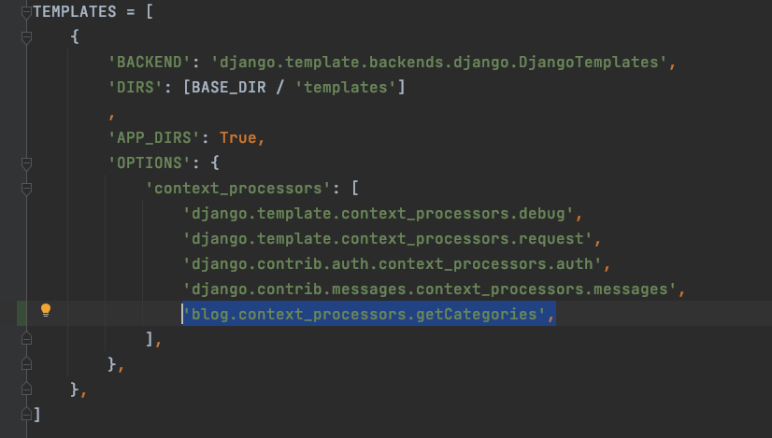
settings

Slide 43
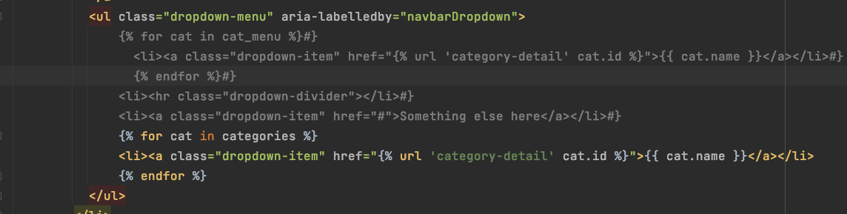
Base.html

Slide 44
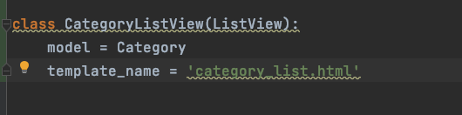
Create a category list view

Slide 45
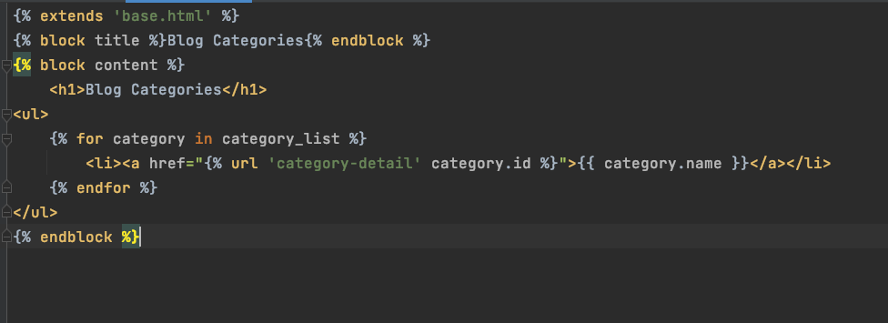
template

Slide 46
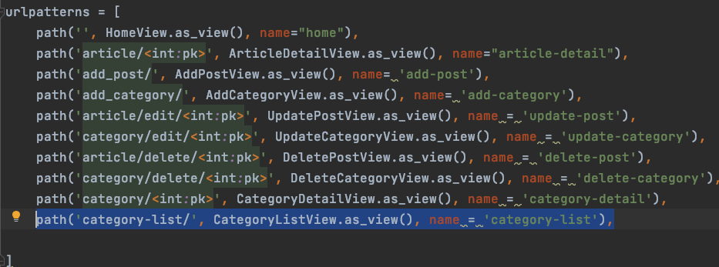
Register to urls

Slide 47
Permission
Who can do what …

Slide 48
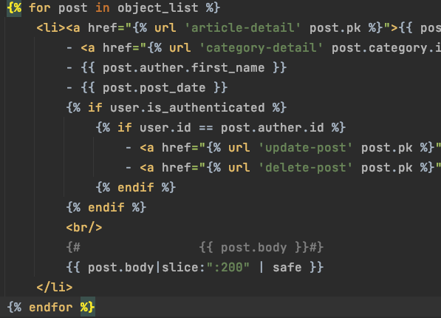
Check user id
Home.html

Slide 49
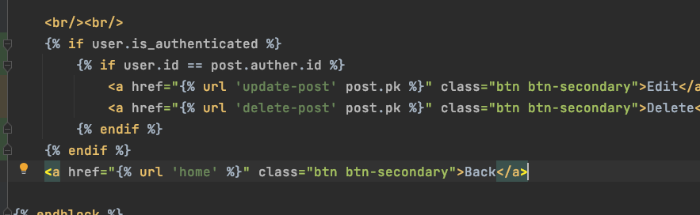
Detail page

Slide 50
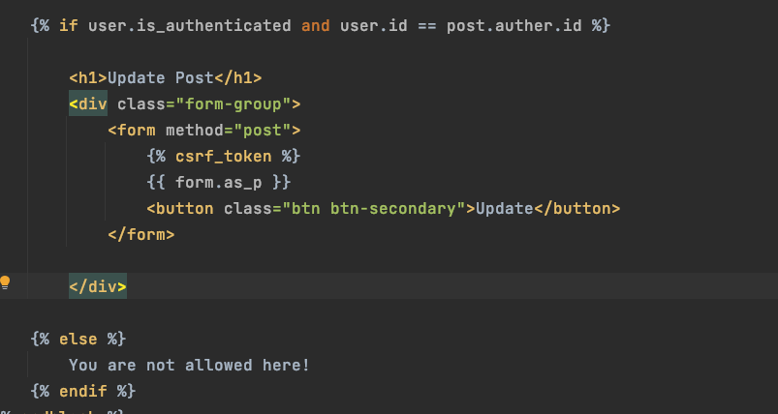
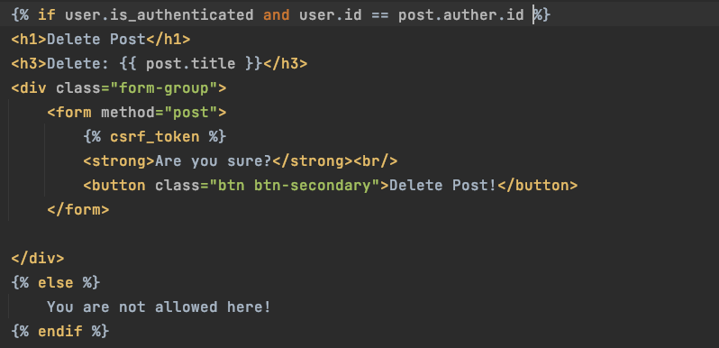
Update and Delete page

Slide 51
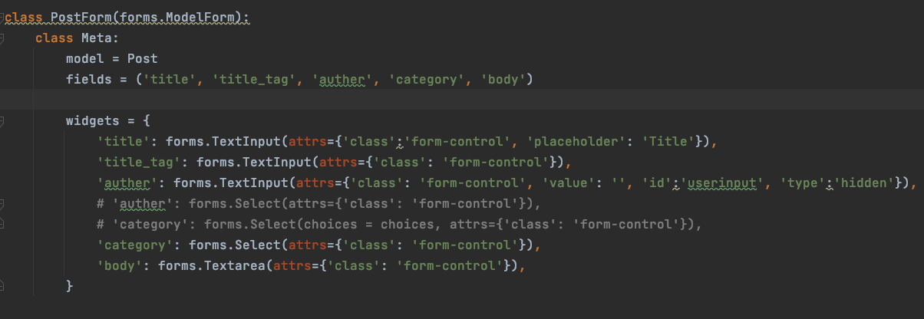
Login author creates Posts

Slide 52
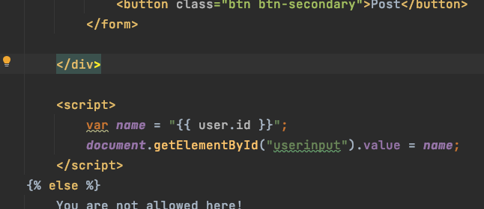
Little bit javascript
add_post.html

Slide 53
Source
https://www.youtube.com/watch?v=TAH01Iy5AuE&list=PLCC34OHNcOtr025c1kHSPrnP18YPB-NFi&index=17&ab_channel=Codemy.com
9 - 17

